Slide 1
WAIR Hackathon- 2022
Team IV (Team Wonderwomen)
Members Name :
Tabea Voß
Akashleena Sarkar
Guided By:
Sadiqui Siddique

Slide 2
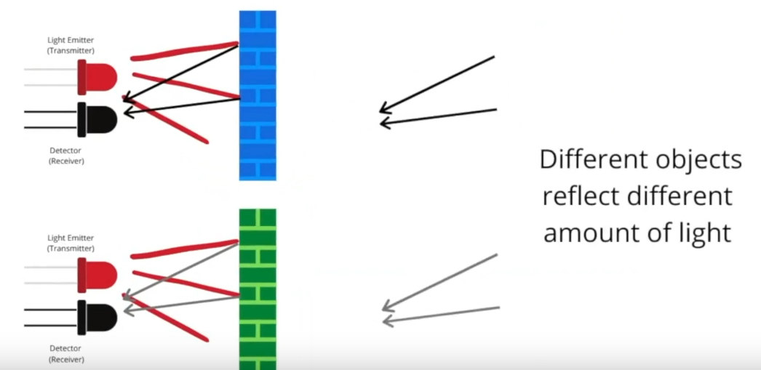
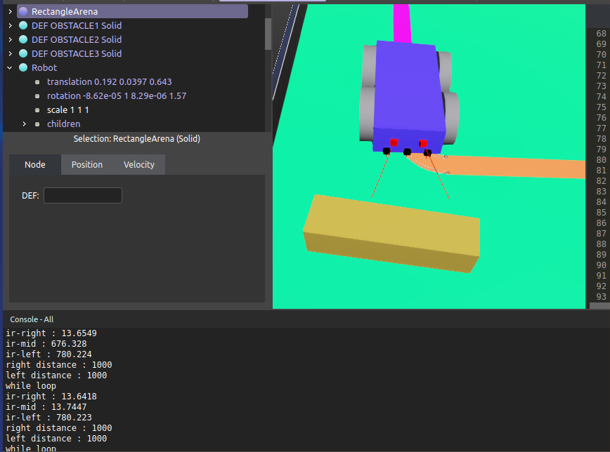
Task 1: Line Following Mobile Robot in Webots
Fig 1.1 Working of an IR sensor
(Red : LED , Black : Phototransistor)
Notes:
IR sensor have a light emitter (LED ) and a light detector called phototransistor, depending on type of material and colour different objects will reflect diff amt of light. Based on the value of light that was reflected back we can detect different objects …
Explain the second image how we did experiments - Green ground has sensor value 14 yello line has sensor value around 600-700

Slide 3
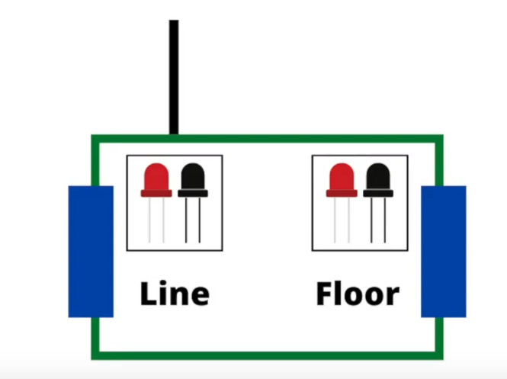
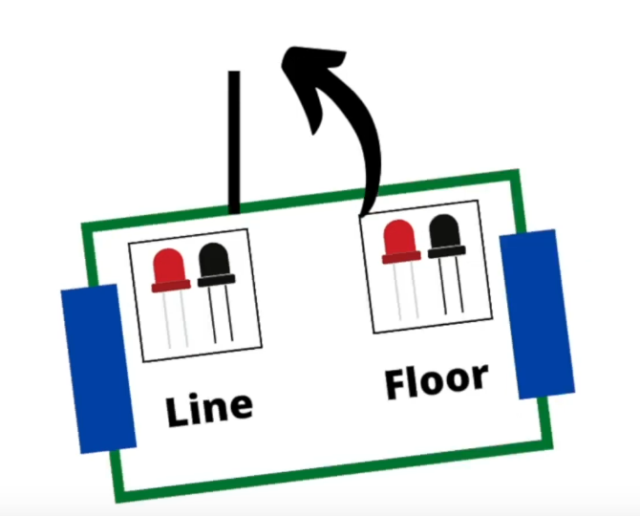
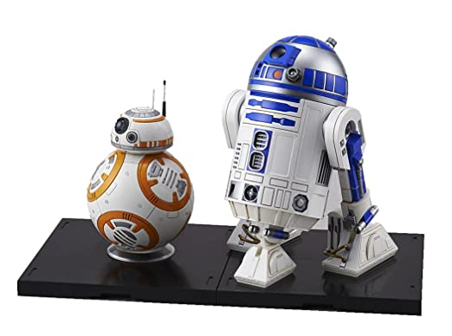
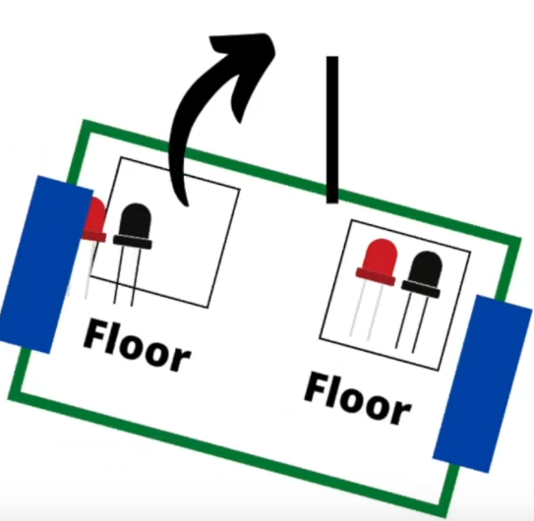
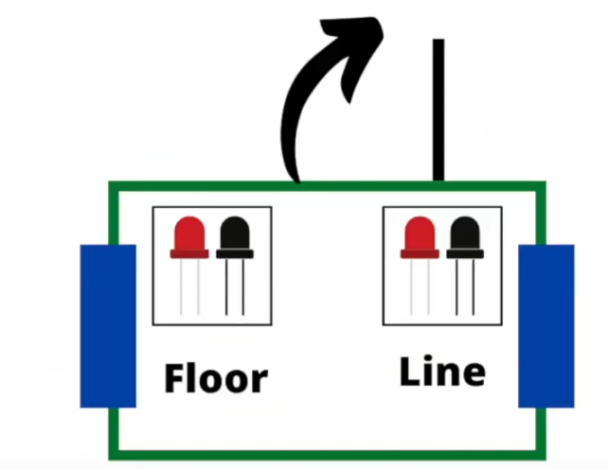
How did we code???
Easy-peasy
If - else statements
BB-8
R2-d2
Star Wars

Slide 4
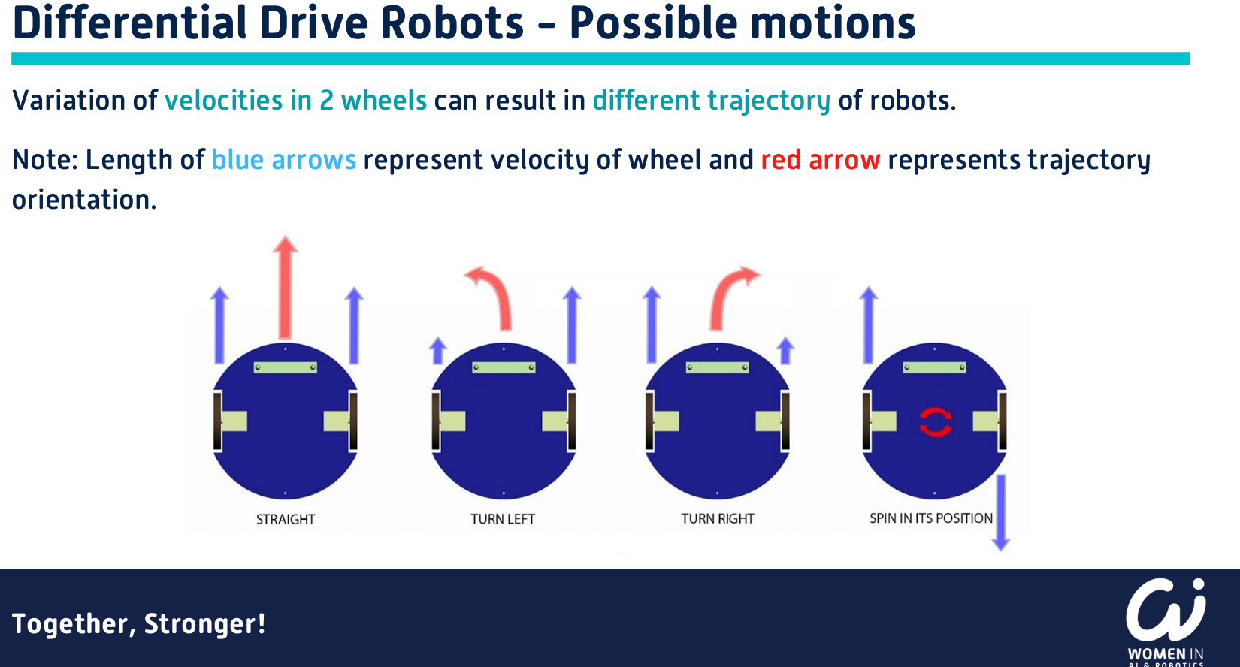
Coding Approach
Experiment with sensors to detect IR values of the line
Results: line values range around 700, ground values about 13
Presumption: all line values are between 600 and 800
Boolean variable for IR sensors (left and right) to test if sensor on the line
If line curves to right:
left IR sensor values are smaller than the right ones
right IR sensor values in line value range
move the right wheels 0.1 times as fast as the left ones
Pivot point next to right wheel beside the robot
If line ends all values are between 12 and 15

Slide 5
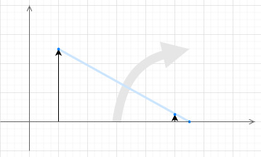
Adjustments to trajectory
The robot went off the line while turning
Slow the velocity of the wheels to follow a pivot point closer to the robot
The robot moved in a zig-zag pattern on a straight line
Reason: too far of a turn was taken
Adjustment to the speed of the slower wheel
Right proportions: speed * 0.1

Slide 6
Different Approach / Advancement
Line values are hardcoded into the program
make the robot more versatile to line colors
IR values of the line are measured by middle IR sensor
Replace the range of line values (600 - 800) to middle sensor values with an error margin of +100 and -100
Applicable only if
Line color values still in high contrast to the ground

Slide 7
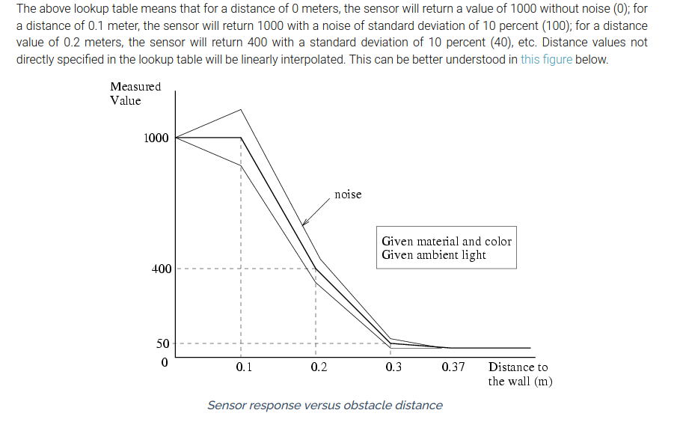
Task 2: Stop the robot in front of the obstacle at a distance of 4cm
if(((ds_right_val <= 90) &&
((ds_left_val <= 90)
{
left_speed = 0;
right_speed = 0;
}
From the plot, the sensor value to stop the robot at a distance of 4 cm from the obstacle is 0-50, but due to inertia of motion of the moving wheels it was stopping too close to the obstacle and colliding with it, so we took a sensor value of 90
Ref: https://cyberbotics.com/doc/reference/distancesensor

Slide 8
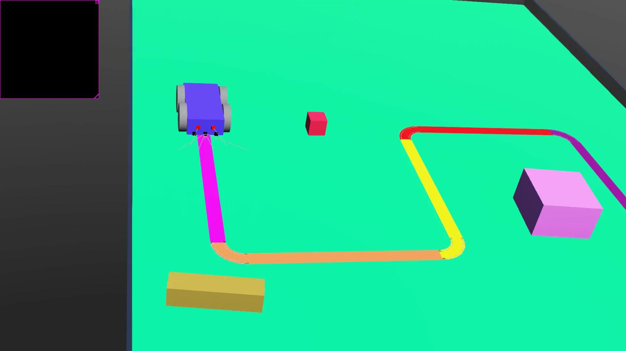
Demo Videos
Line follower Robot

Slide 9
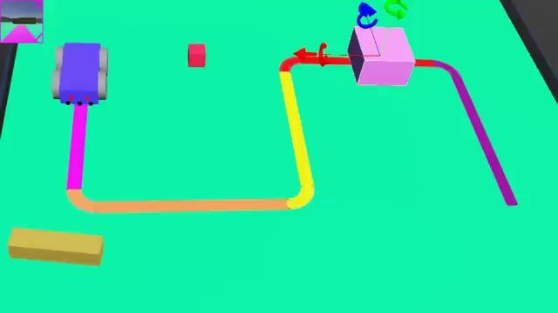
Demo Video - Task 2
Obstacle detection

Slide 10

Demo Video: Bonus Task

Slide 11
[Extra Slide]Bonus task: ball sorting
Different robot : two wheels, three motors for gripping and lifting, no sensors
Define function to grip
The two grip motors are moved at the same velocity to the same position
Define function to turn on the spot
move one wheel backwards and the other froward
Easiest trajectory was to always turn on the same point (not shortest path)
Problems faced:
The ball would bounce out of bin if not placed there gentally
Trial and error to position robot precisely in front of each ball
Misinterpretation of an error message to mean no negative velocity allowed
mistakenly using the function setPosition() to turn the robot

Slide 12
Thank you for listening to our presentation!
Are there any questions?

